Slide 1
Final Project Presentation:
Opener Strategy in the MLB
By Jack Byrne and Harry Svendsgaard

Slide 2
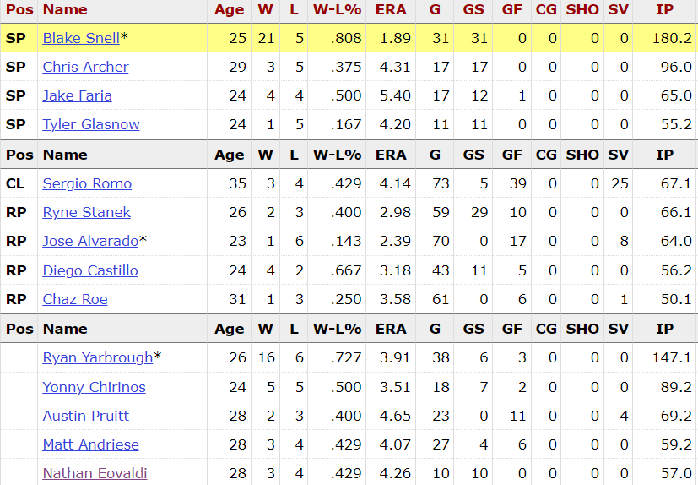
Background
Refers to the use of a non-starting pitcher to get the first outs of the game
Replaced by a long reliever or typical starting pitcher
Strategy became most popular in 2018 with the Tampa Bay Rays
Notes:
Believed that the more times a pitcher faces the same batter, the batter begins to have more of an advantage.
First inning is typically highest scoring… Use closer to shut down top of opposing team’s lineup.
Tampa used this strategy in 2018, where they would start players like Sergio Romo, Ryne Stanek, and Diego Castillo, who have been relievers their whole career. As you can see in the screenshot, Ryan Yarbrough was second on the team in innings pitched with 147, but only started 6 games.

Slide 3
Benefits
Used to potentially lock a team into a lineup that is less favorable against the pitcher that will come in after the opener
Teams play their right handed pitcher lineup because of opener and team brings on left handed pitcher after opener
Throw off timing of first few batters (typically most dangerous hitters)
Allows the typical starter to begin work against the weaker part of the lineup
Financial perspective, it allows teams to get more out of lower salary relievers, and less starts/decisions for the guys that make more money
Notes:
Hitters not used to seeing different pitchers every time up to bat.

Slide 4
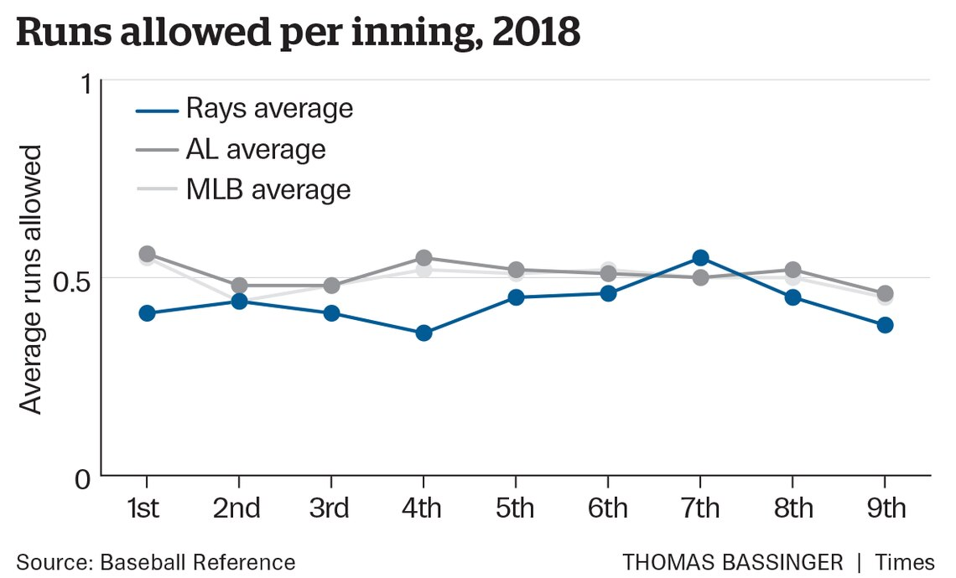
Results from Various Teams
Rays team ERA was lower when using an opener
Openers had 3.97 ERA in 93 innings pitched, compared to the 4.15 league average
Oakland A’s used strategy for 9 games, posting a 4-5 record with a 1.86 ERA
Yankees used Chad Green in 15 opener scenarios and won 11 of the games he opened
Angels threw a combined no hitter in 2019 using Taylor Cole to work the first two innings, and Felix Pena to go the last seven
Notes:
The Tampa Bay Rays finished the 2018 season with a 90-72 record, and failed to make the playoffs.
Lower ERA could also be accredited to Blake Snell, the Cy Young winner being phenomenal down the stretch.
A lot of teams followed by trying out the opener strategy at the end of the 2018 season. Liam Hendricks, an all star closer was primarily used as an opener for the Oakland A’s during this time, and was used in this role in the AL wild card game, which they ended up losing.

Slide 5
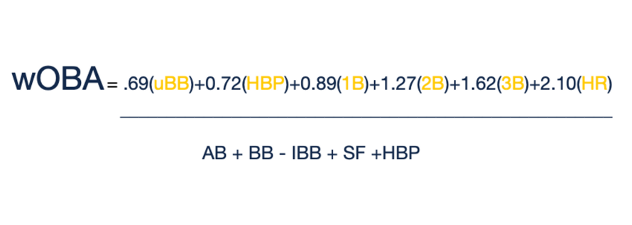
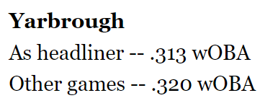
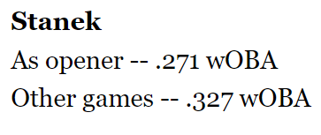
wOBA Overview
Use wOBA to determine how useful the the opener strategy is
Measures a player’s overall offensive contributions per plate appearance

Slide 6
Times Faced wOBA (2021)
wOBA is scaled like OBP
First PA: .319
Second PA: .331
Third PA: .343
Fourth PA: .317
Statcast pitch by pitch data from 2021 season

Slide 7
Third Time Through wOBAs
Batting Order Spot | wOBA | PAs | Weight
1 | .341 | 3819 | 1301
2 | .359 | 3536 | 1271
3 | .386 | 3211 | 1239
4 | .357 | 2748 | 981
5 | .340 | 2287 | 777
6 | .328 | 1738 | 586
7 | .317 | 1286 | 408
8 | .235 | 869 | 205
9 | .234 | 568 | 133
Early batting order spots have a stronger influence on overall 3rd time through wOBA than late batting order spots
Check that this is right (equals same wOBA from previous slide: .343)
Take Weighted Average wOBA (PAs as weight)
Sum(Weight)/Sum(PAs) = .343

Slide 8
Third Time Through wOBAs With Opener
Batting Order Spot | wOBA | Shifted PAs | Adj Weight
1 | .341 | 1738 | 609
2 | .359 | 1288 | 463
3 | .386 | 869 | 335
4 | .357 | 568 | 203
5 | .340 | 3819 | 1298
6 | .328 | 3536 | 1160
7 | .317 | 3211 | 1018
8 | .235 | 2748 | 647
9 | .234 | 2287 | 536
Shift so that opener faces first 4 batters, starter comes in to face 5th batter and on
Third time through starts at 5th batter
Take Weighted Average wOBA (PAs as weight)
Sum(Weight)/Sum(PAs) = .312
With all else equal, opener would lower 3rd time through wOBA by about .030 points in wOBA

Slide 9
Model
MLR
Formula: Runs Allowed = opener(T/F) + pitching team + hitting team
Model was very weak
Predicted that .22 more runs would be allowed with an opener
Selection Bias- Good starting pitchers don’t use openers
Not enough instances of an opener being used
Not prevalent enough to accurately model
Openers (faced < 7 batters) used 1.89% of the time in 2021 (92 instances)
Used at least once by 27/30 teams
Only LAD and TB used an opener 10+ times

Slide 10
Conclusion
Opener has not been used enough to confidently determine if it is beneficial or not
Different teams have had success using the opener strategy
Mixed emotions on the strategy in the league
Notes:
Zack Greinke is not an advocate, as he thinks it causes problems in determining how to pay player’s. Could be somewhat addressed in CBA negotiations

Slide 11
Score Predictions
xScore: gives expected score given other factors in the game
Sometimes the score doesn’t reflect how the game went
Example: goals vs xG in soccer
Very complex calculations due to variability in different sports
Takes into account different factors for each sport
Our game predictions compared to xScore:
Best 3 in MSE: Harry, Jack, Dr. Sabin
Best 3 in MAE: Jack, Harry, Dr. Sabin
Comparing predictions to xScore is more representative of true ability to predict a game

